Slide 1



SIMATS ENGINEERING
Saveetha Institute of Medical and Technical Sciences
Chennai-602105
AI-Based Virtual Clinical Trial Simulator for Drug Dosage Prediction
CSA1712 - Artificial Intelligence
Presented By
Rathika. S (192419042)
Sowmiya. D (192511063)
Poorna. B (192524094)
Sandhya. B (192311292)
Guided By
Dr. R. Veeramani

Slide 2


Introduction
Drug development is a complex and lengthy process.
Clinical trials require significant time, cost, and resources.
Patients can respond differently to the same drug and dose.
Age, weight, health conditions, organ function, and genetics can influence drug response.
Selecting a suitable drug and dose is therefore a challenging task.
AI can analyze patient and drug-related factors to support prediction.
Virtual clinical trials can test treatment scenarios using synthetic patients.
Simulation helps study efficacy, risk, and dose-response patterns.
This project combines AI, drug comparison, and virtual patient simulation.
The proposed system provides an in-silico approach for early-stage drug and dosage analysis.

Slide 3
Problem Statement
Problem Statement
Difficult to evaluate drug response for different patient profiles.
Testing multiple dose levels can require large trial populations.
Conventional trials require significant time and resources.
Patient variability makes dose selection more complex.
Early-stage population analysis is difficult using only real patients.
Problem addressed
A simulation-based system is needed to compare drugs, analyze dose-response behavior and evaluate treatment performance across synthetic patients.

Slide 4
Objective
Primary Objective
To develop an AI-based virtual clinical trial simulator for drug dosage prediction and treatment comparison.
To Develop a structured patient medical profile.
To Provide treatment and drug selection.
To Compare candidate drugs using AI-based analysis.
To Predict the best simulated dose.
To Generate synthetic virtual patients.
To Analyze efficacy, risk and dose-response.

Slide 5
Proposed System
Working of the Interactive Tool
Patient Profile Input — Enter demographic, medical, allergy, and medication details.
Treatment Selection — Select the condition or treatment area.
Drug Selection — Choose one or two existing or experimental drugs.
AI Analysis — Analyze patient and drug-related factors.
Dose Simulation — Test multiple dose levels and calculate simulated efficacy and risk.
Virtual Patient Generation — Create a synthetic patient cohort.
Virtual Trial — Evaluate the selected drug across the virtual population.
Final Analysis — Display the best simulated dose, graphs, and trial results.
Patient Medical Profile
Treatment & Drug Selection
AI Drug Comparison
Dose-Response Simulation
Synthetic Virtual Patients
Virtual Clinical Trial

Slide 6
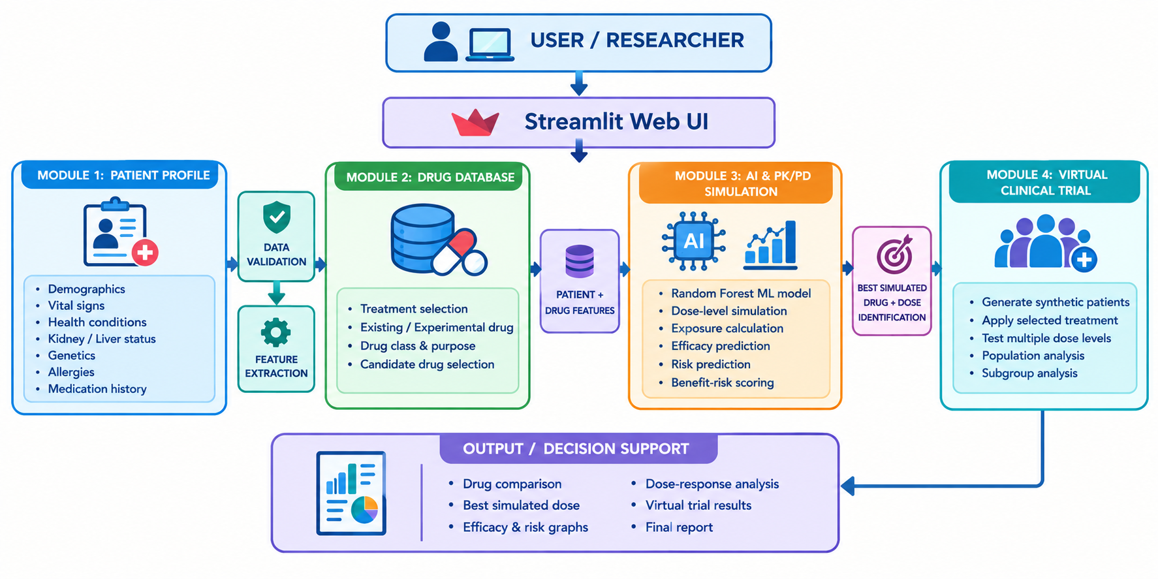
System architecture

Slide 7
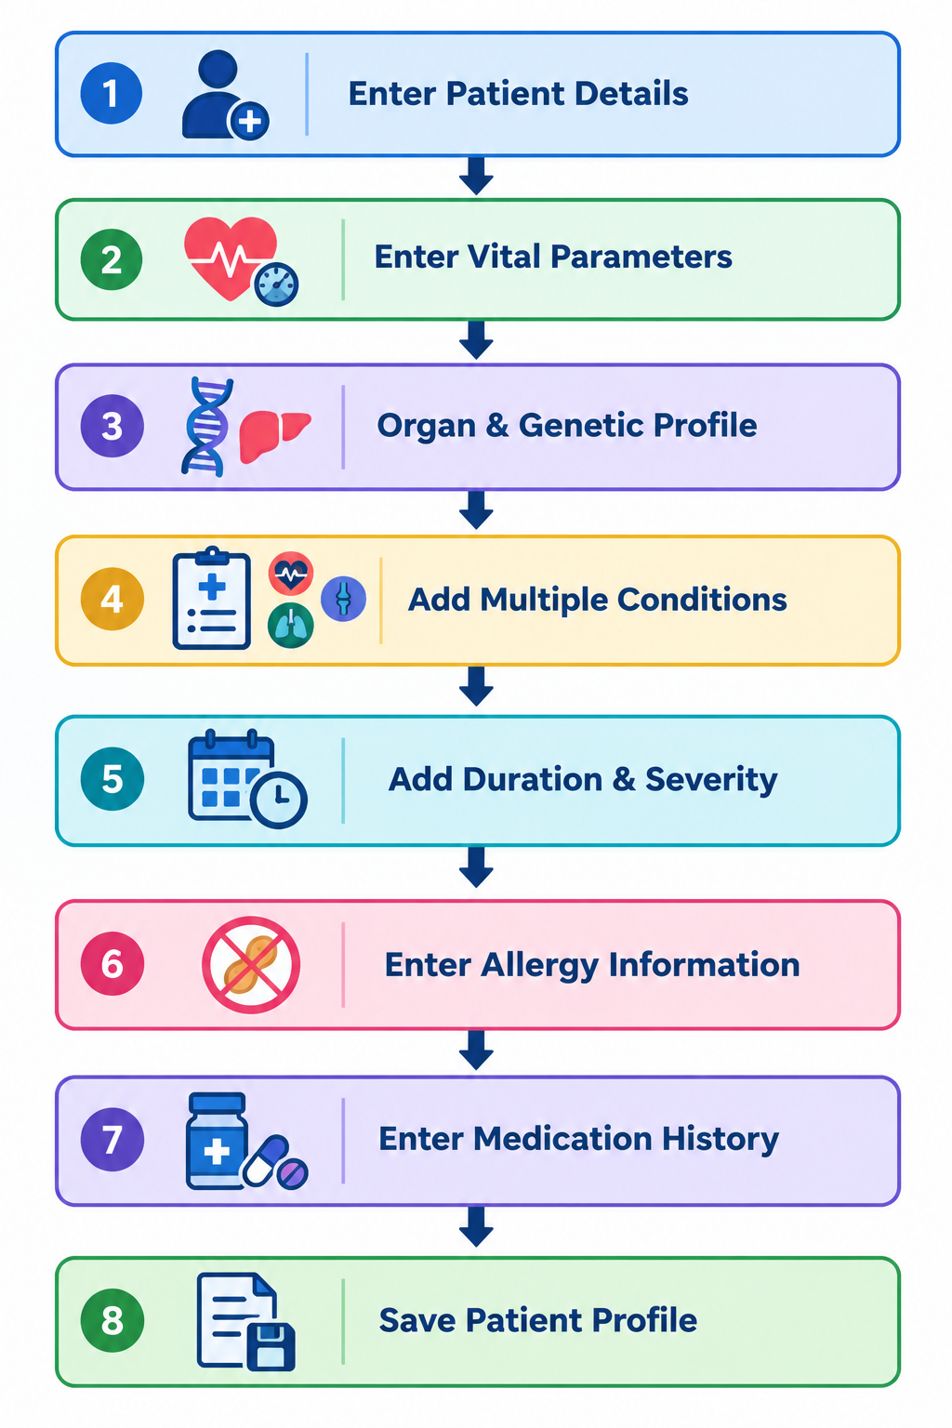
Module 1: Patient Medical Profile
Description
Module 1 collects and organizes the patient's information required for simulation.
Inputs
Patient demographics and vital signs
Kidney and liver condition
Genetic drug-processing category
Multiple health conditions
Condition duration and severity
Allergy information
Current/previous medications
Output
Structured Patient Profile → Module 2

Slide 8
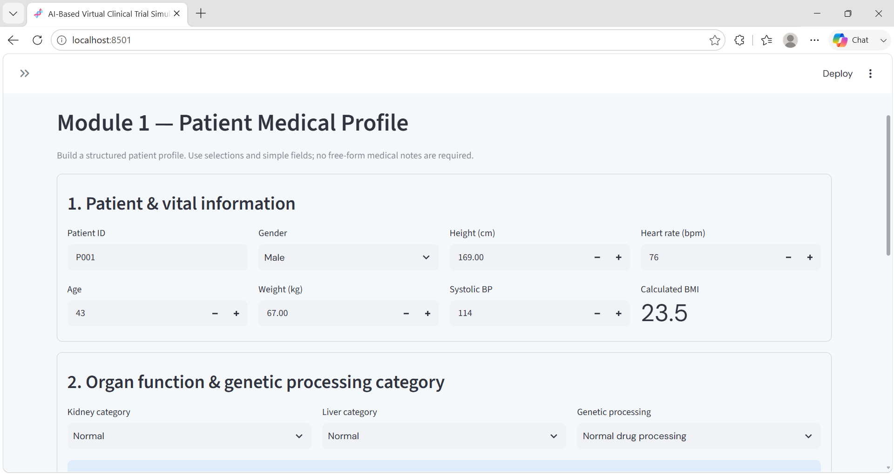
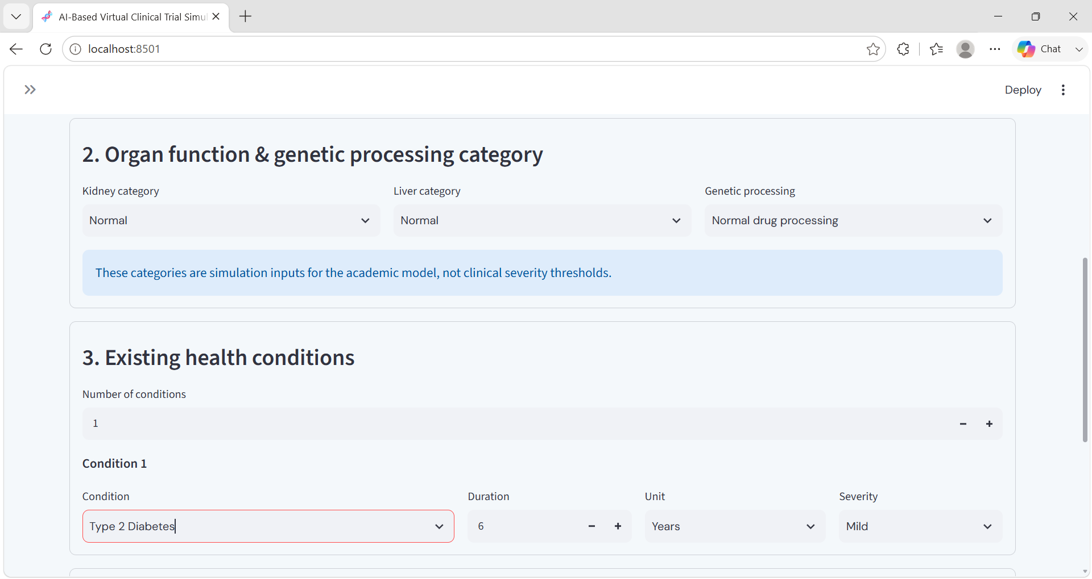
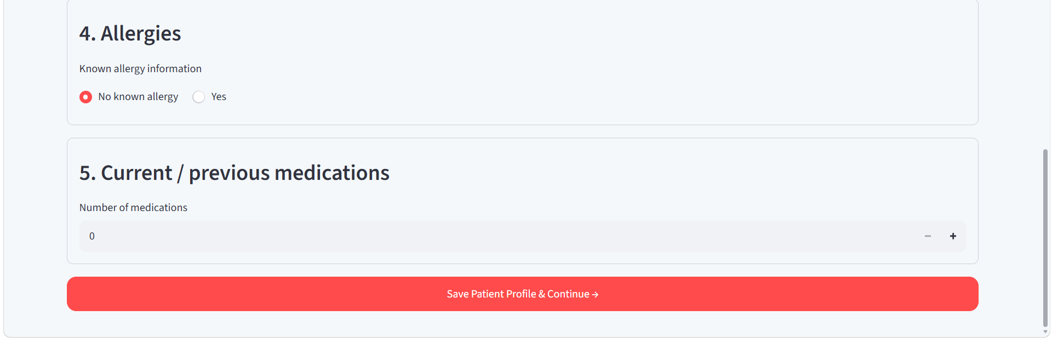
Module 1 – Website Implementation

Slide 9
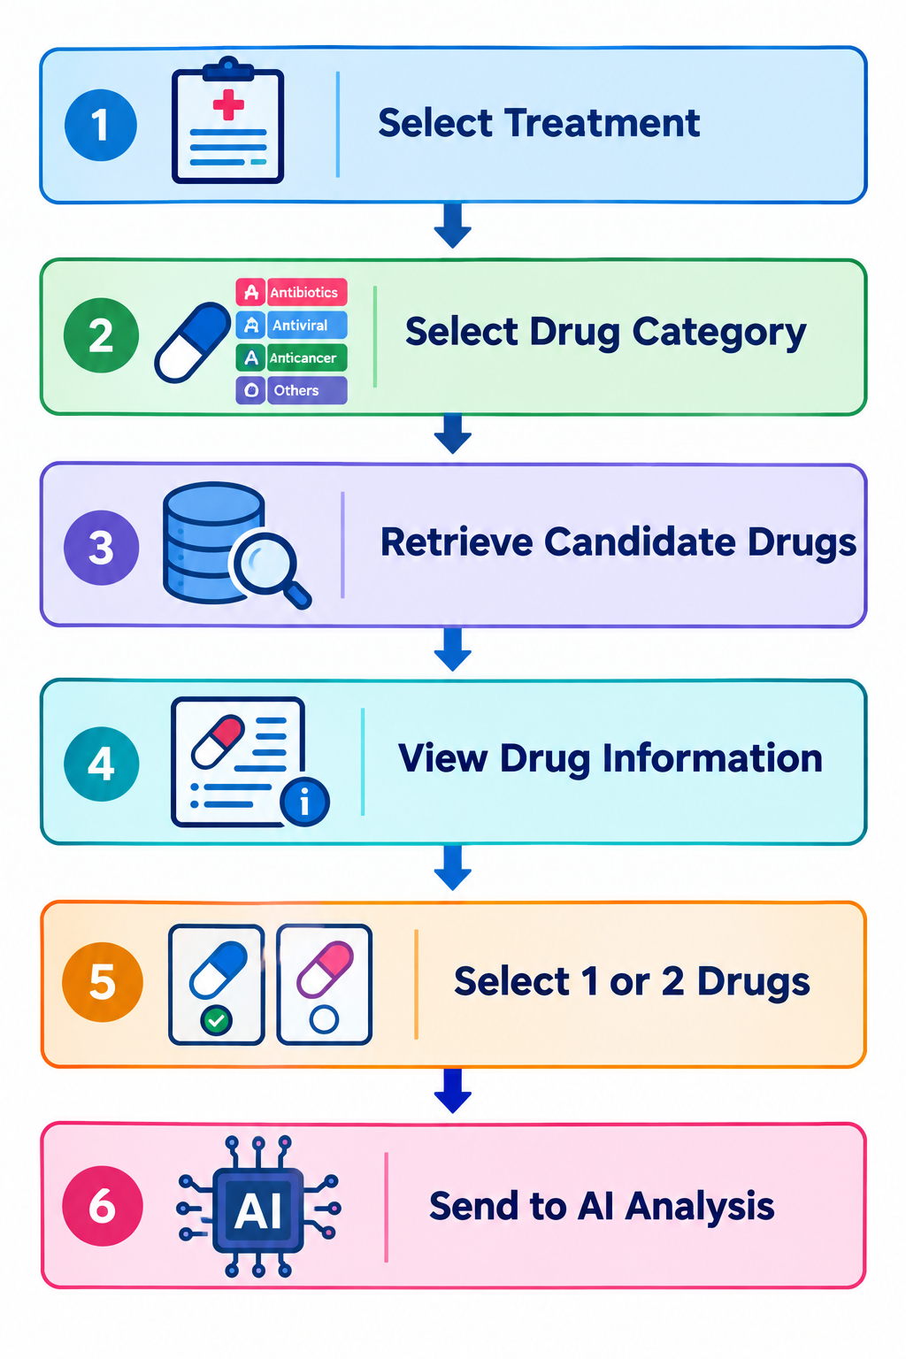
Module 2: Treatment & Drug Selection
Description
Module 2 identifies the treatment area and provides suitable candidate drugs for simulation.
Process
Select treatment/condition
Choose Existing or Experimental Drug
Display drug information
View drug class and purpose
Select one or two candidate drugs
Output
Selected Drug Candidate(s) → Module 3
Important
Dosage selection is performed in Module 3.

Slide 10
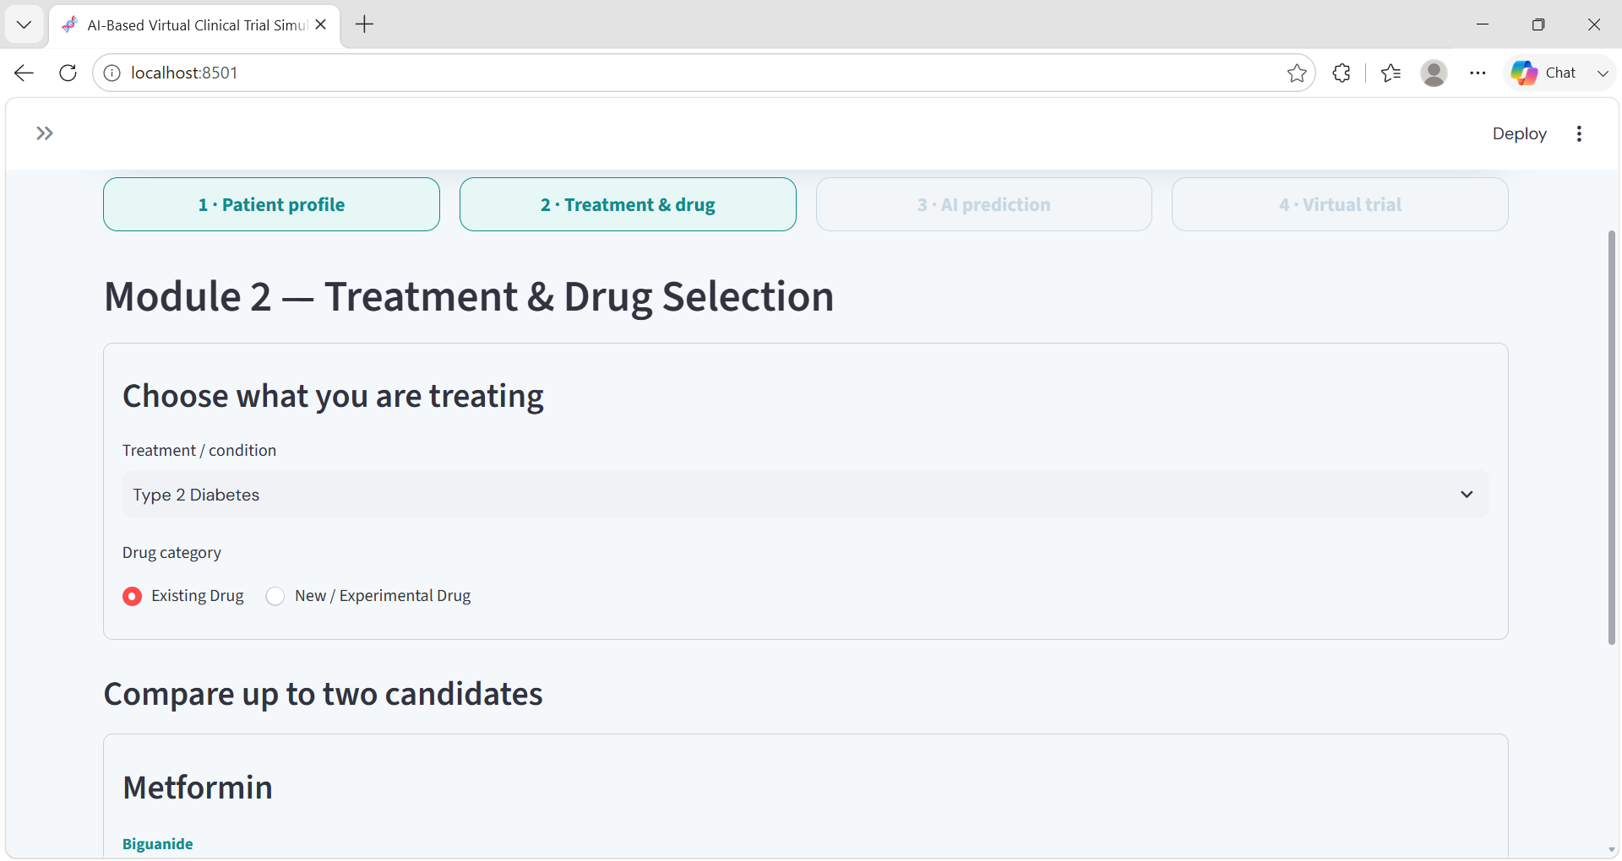
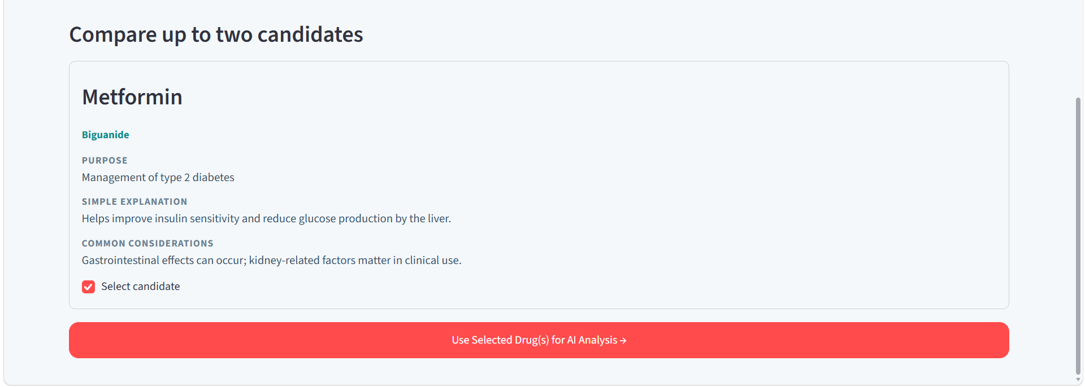
Module 2 – Website Implementation
Treatment Selection — The researcher selects the condition or treatment area.
Drug Category — Existing or experimental drug can be selected.
Drug Information Cards — Each drug displays its name, class, purpose, and simple explanation.
Drug Comparison — One or two candidate drugs can be selected for comparison.
Patient Context — The selected treatment is considered along with the patient profile from Module 1.
Continue to Analysis — Selected drugs are passed to Module 3 for AI-based comparison and dose analysis.

Slide 11
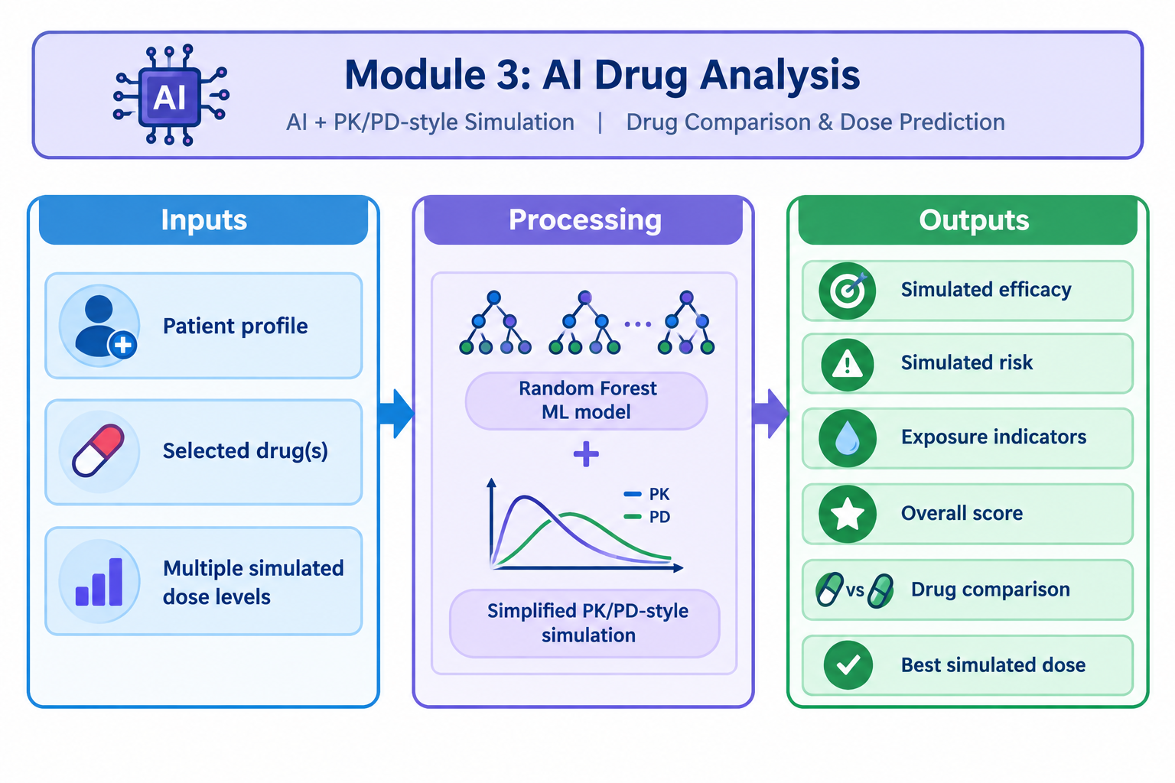
Module 3: AI Drug Comparison & Dosage Prediction
Inputs
Patient profile
Selected drug(s)
Multiple simulated dose levels
Processing
Random Forest ML model + simplified PK/PD-style simulation
Outputs
Simulated efficacy & Simulated risk
Exposure indicators
Drug comparison
Best simulated dose
Description
Module 3 is the core AI and simulation module of the project.

Slide 12
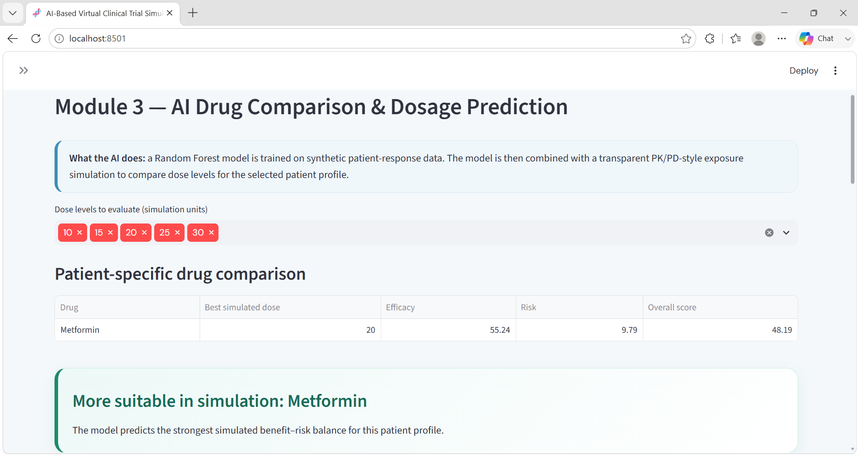
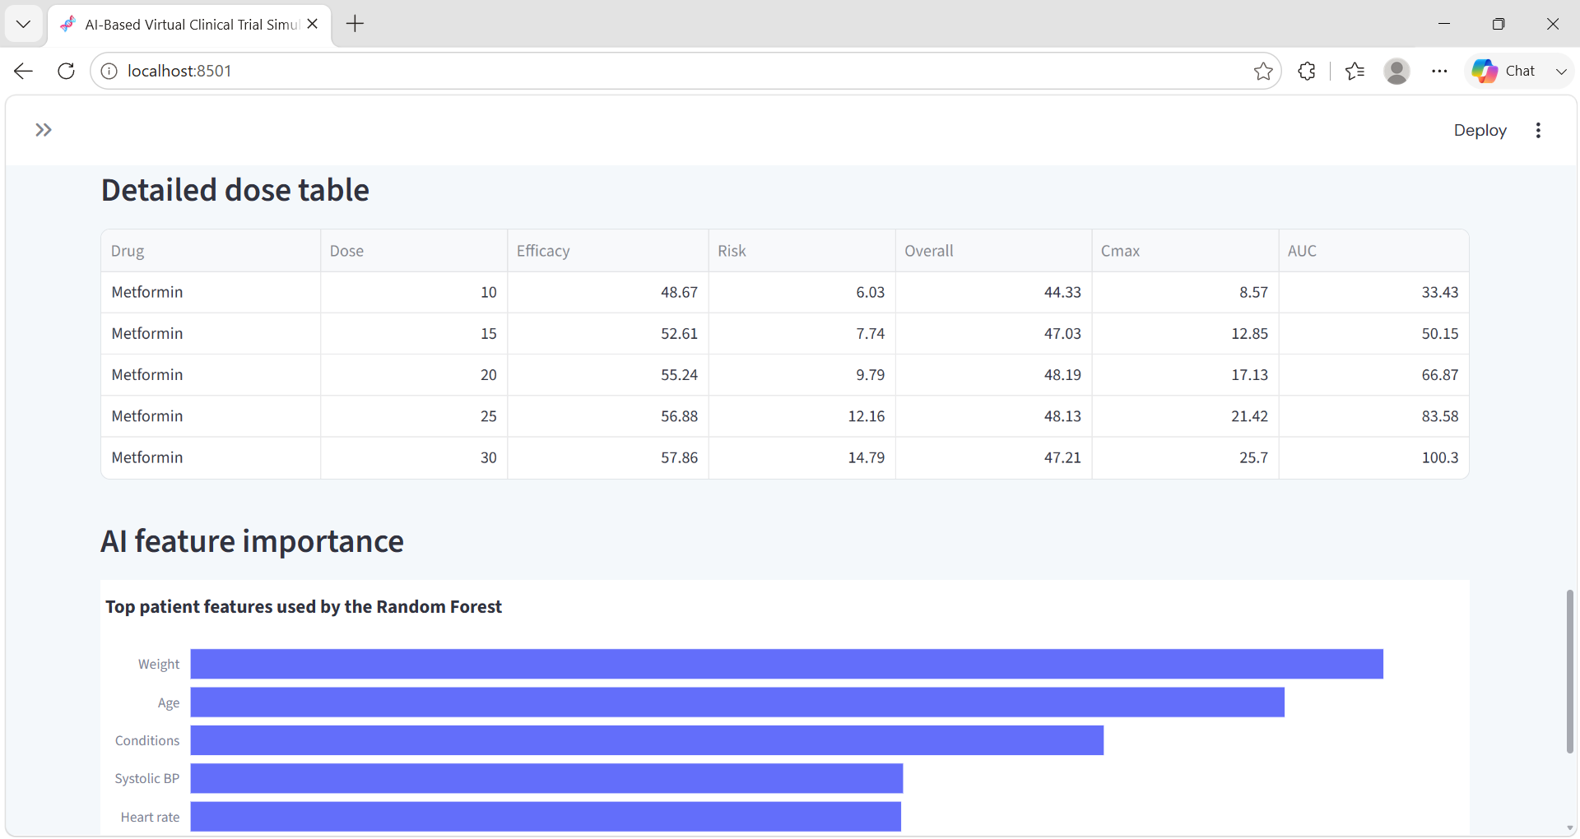
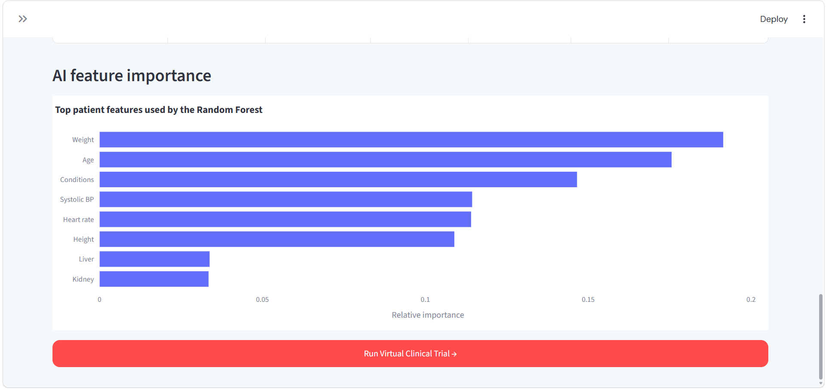
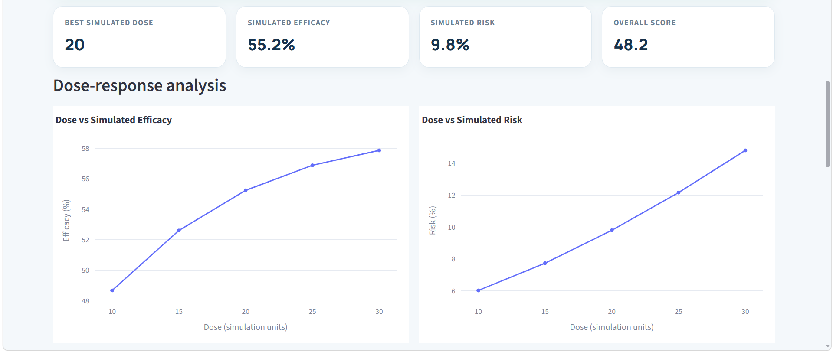
Module 3 – Website Implementation

Slide 13
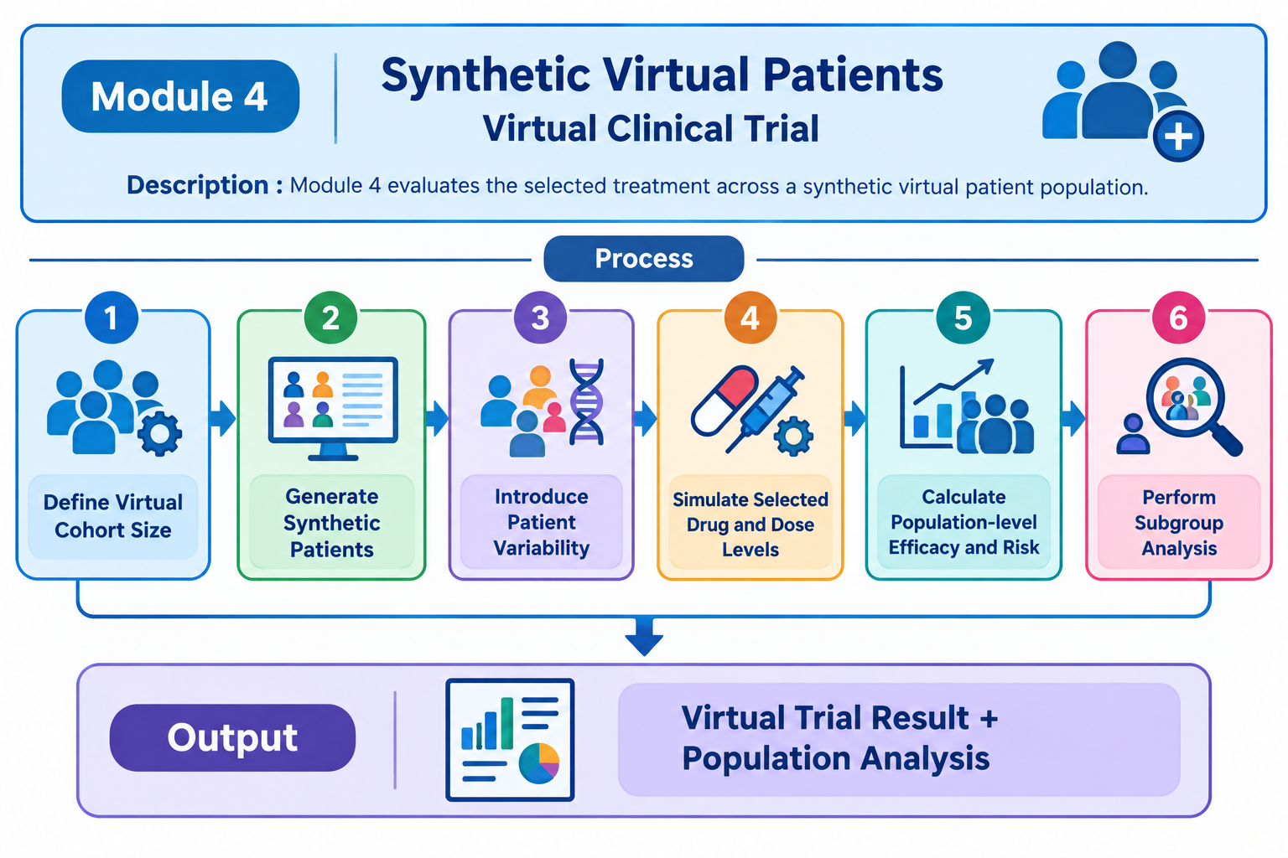
Module 4: Virtual Clinical Trial & Final Analysis
Process
Define virtual cohort size
Generate synthetic patients
Introduce patient variability
Simulate selected drug and dose levels
Calculate population-level efficacy and risk
Perform subgroup analysis
Output
Virtual Trial Result + Population Analysis
Description
Module 4 evaluates the selected treatment across a synthetic virtual patient population.

Slide 14
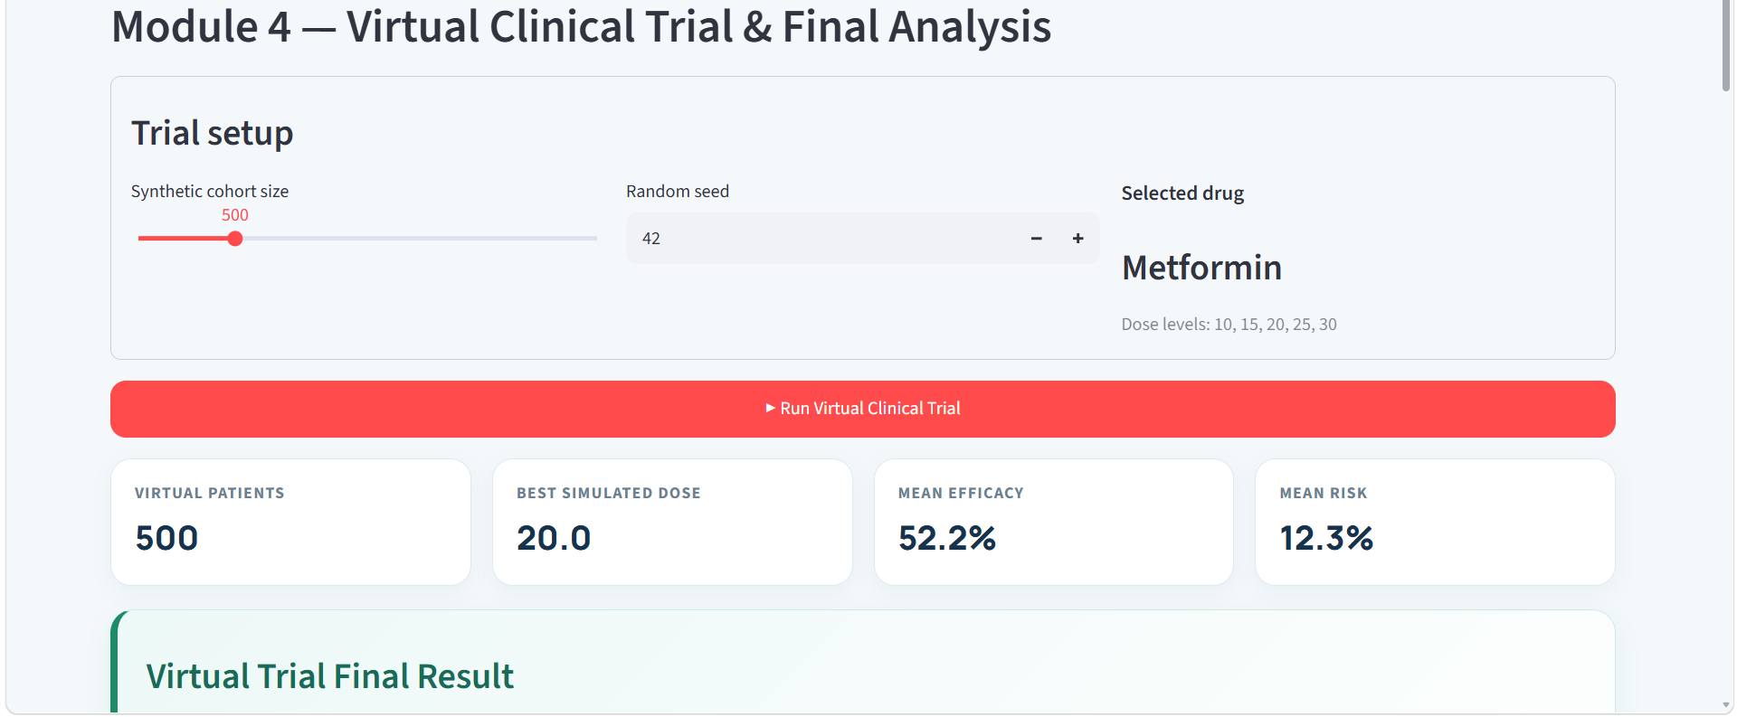
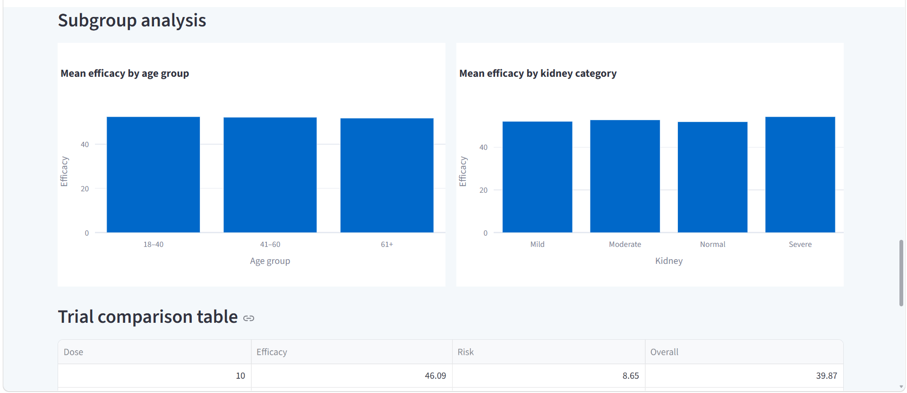
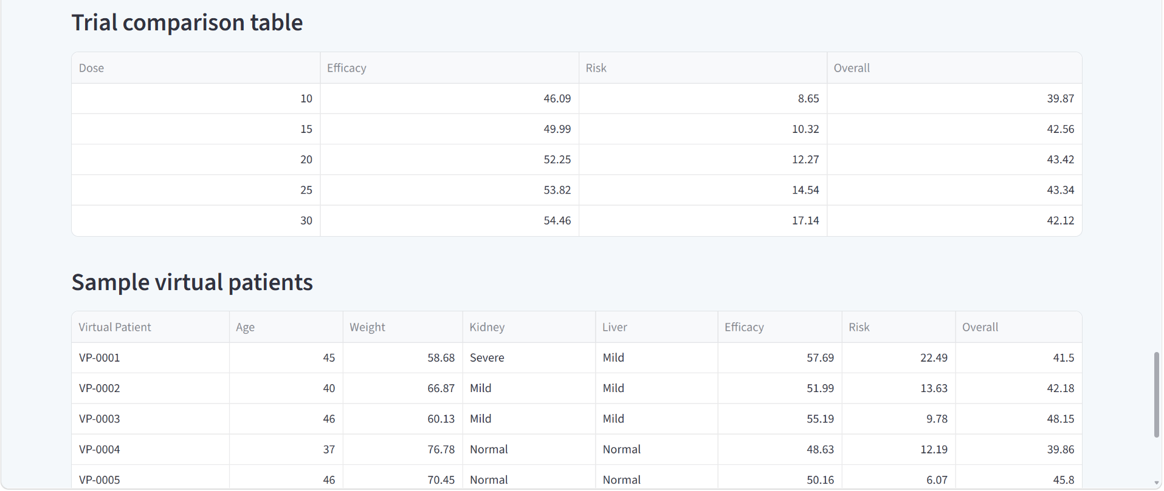
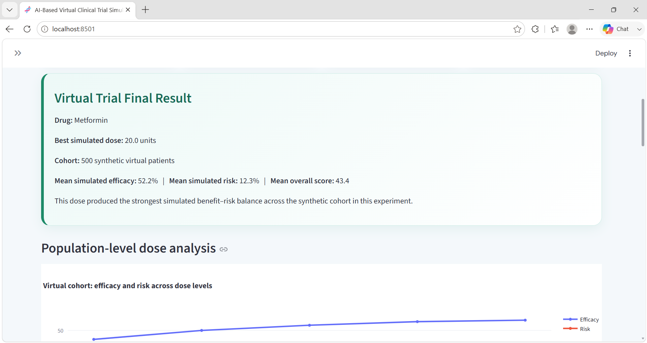
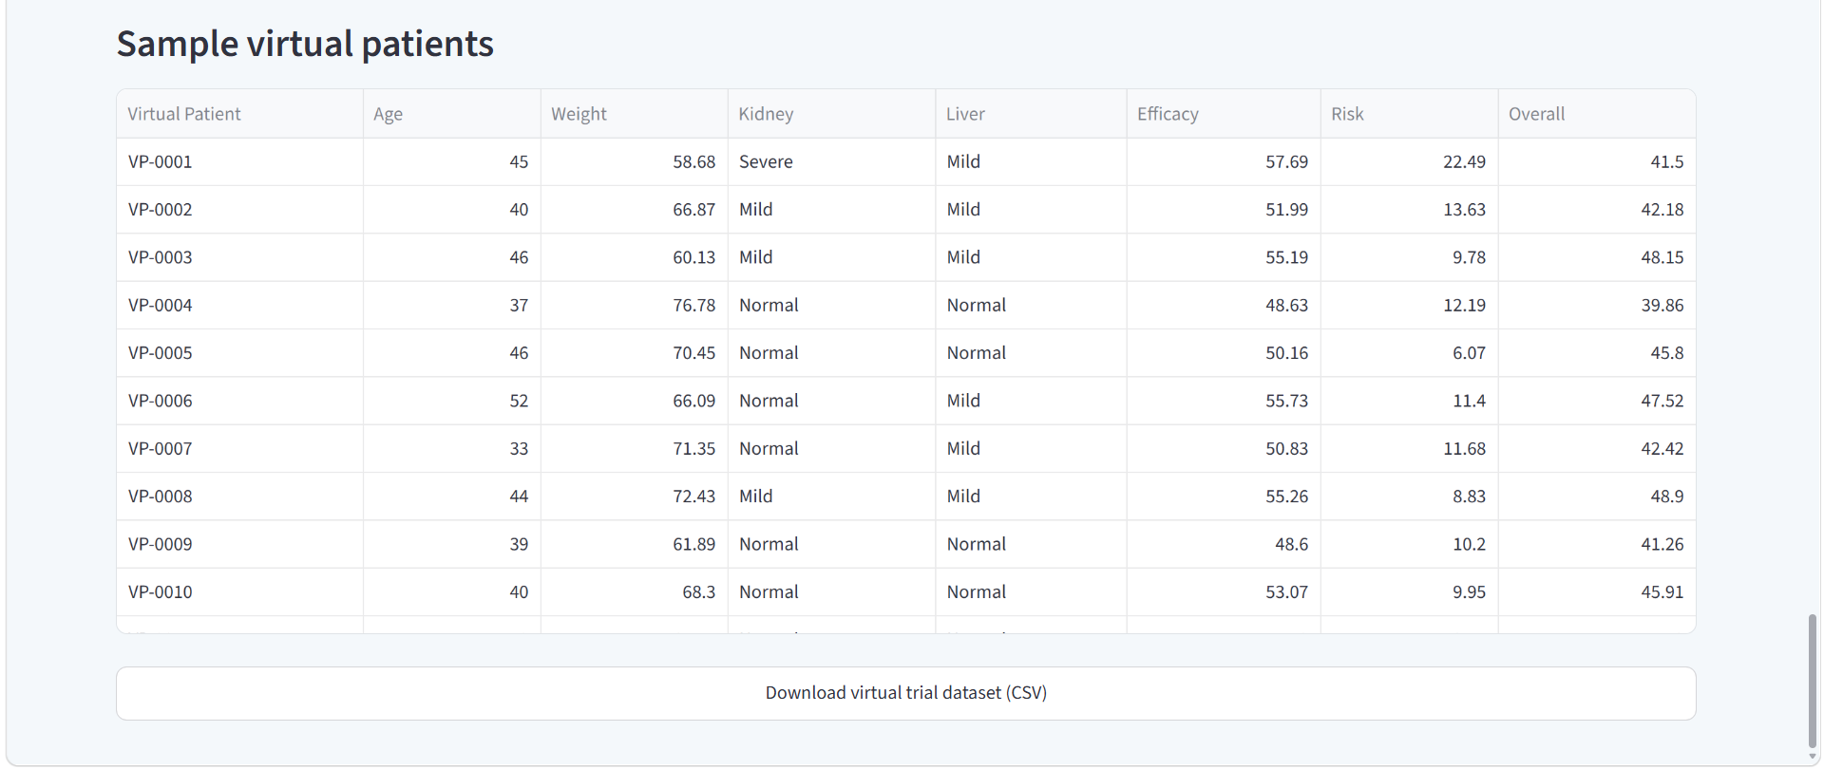
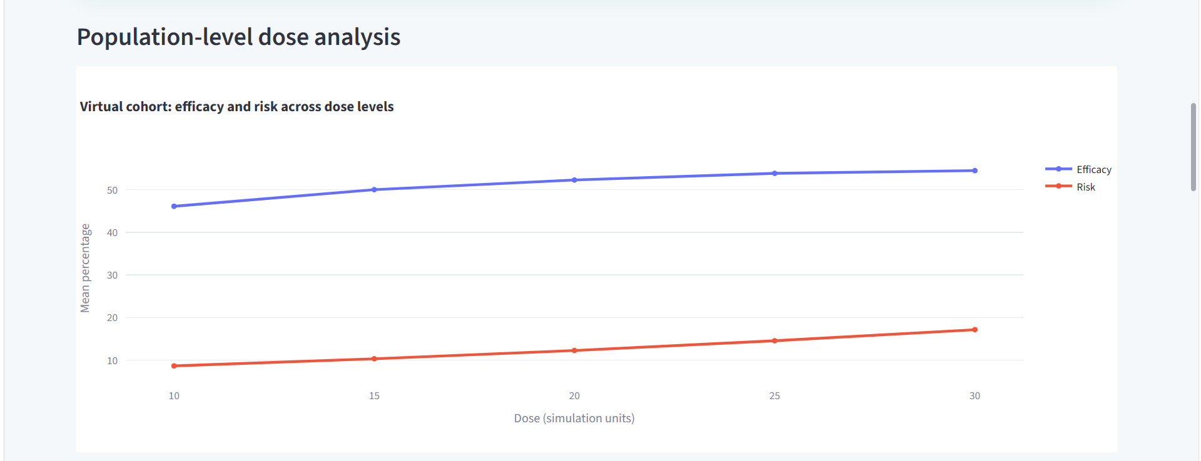
Module 4 – Website Implementation

Slide 15
Result
Patient Profiling — Successfully captures patient demographics, conditions, allergies, and medication history.
Drug Comparison — Compares one or two candidate drugs using patient-specific factors.
AI-Based Prediction — Evaluates different dose levels using the ML model and simulation.
Dose-Response Analysis — Generates simulated efficacy, risk, exposure, and overall scores.
Best Simulated Dose — Identifies the dose with the highest simulated benefit-risk balance.
Virtual Trial Analysis — Evaluates treatment performance across the synthetic population.
Final Trial Result — Provides a consolidated summary of the selected drug, dose, efficacy, risk, and overall performance.

Slide 16
Advantages & Disadvantages
Patient-specific analysis — considers individual patient characteristics.
Drug comparison — evaluates multiple candidate drugs.
Dose-response analysis — compares different simulated dose levels.
Synthetic population testing — evaluates treatment across virtual patients.
Visual analysis — graphs make results easier to interpret.
Flexible simulation — supports different patient and treatment scenarios.
Synthetic data — Uses virtual patient data.
Simplified model — PK/PD simulation is simplified.
Limited drugs — Only a small set of drugs is included in the current prototype.
Model dependent — Prediction quality depends on the training and simulation data used.
No validation — Results have not been validated against real clinical outcomes.
Academic use — The system is designed for academic simulation.

Slide 17
Future Scope
Real Clinical Data
Use validated clinical and pharmacokinetic datasets for improved model training.
Advanced Digital Twins
Develop more detailed patient-specific virtual models.
Combination Therapy
Extend the system to simulate multiple drugs together.
Advanced AI Models
Explore deep learning, Bayesian methods and generative models.
Clinical Validation
Compare simulation results with validated clinical outcomes.

Slide 18
Conclusion
The proposed AI-Based Virtual Clinical Trial Simulator integrates patient medical information, treatment and drug selection, AI-based drug comparison, dose-response simulation, and synthetic virtual clinical trials into a single platform. The system provides both patient-level and population-level analysis of simulated efficacy and risk, helping demonstrate how AI and in-silico methods can support early-stage drug and dosage evaluation. The developed prototype is intended for academic and research simulation, not for clinical prescribing or real-world dosage decisions.

Slide 19
References
[1] M. Bordukova et al., “Generative artificial intelligence empowers digital twins in drug discovery and clinical trials,” Expert Opinion on Drug Discovery, 2024.
[2] P. Ranganathan, R. Aggarwal, and C. S. Pramesh, “Virtual clinical trials,” Perspectives in Clinical Research, 2023.
[3] S. Mtshali and B. A. Jacobs, “Machine learning-based prediction of pharmacokinetic parameters for individualized drug dosage optimization,” International Journal of Information Technology, 2024.
[4] U.S. Food and Drug Administration, “Considerations for the Use of Artificial Intelligence to Support Regulatory Decision-Making for Drug and Biological Products,” 2025.
[5] Relevant recent literature on synthetic patients and virtual clinical trials, 2024.

Slide 20
Thank You

